Slide 1

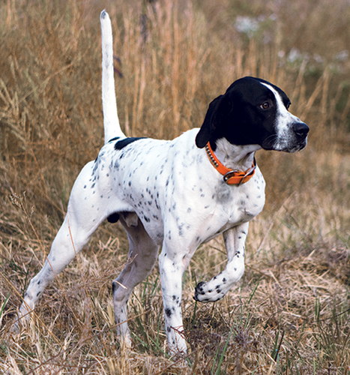
Bird Dog Update
April 25, 2025

Slide 2

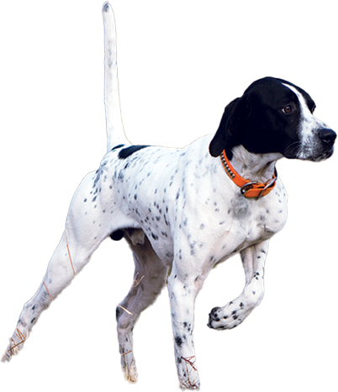
Bird Dog
Set of automation tools to streamline archive acquisition process:
Automate spreadsheet creation and updating
Automate monitoring and reporting of archive page changes
Control the frequency of change reporting
Easy to digest change reporting (embedded in spreadsheet)
Scalable to large number of tracked pages
Self-serve web app
AWS Deployment
Update to current spreadsheet templates

Slide 3
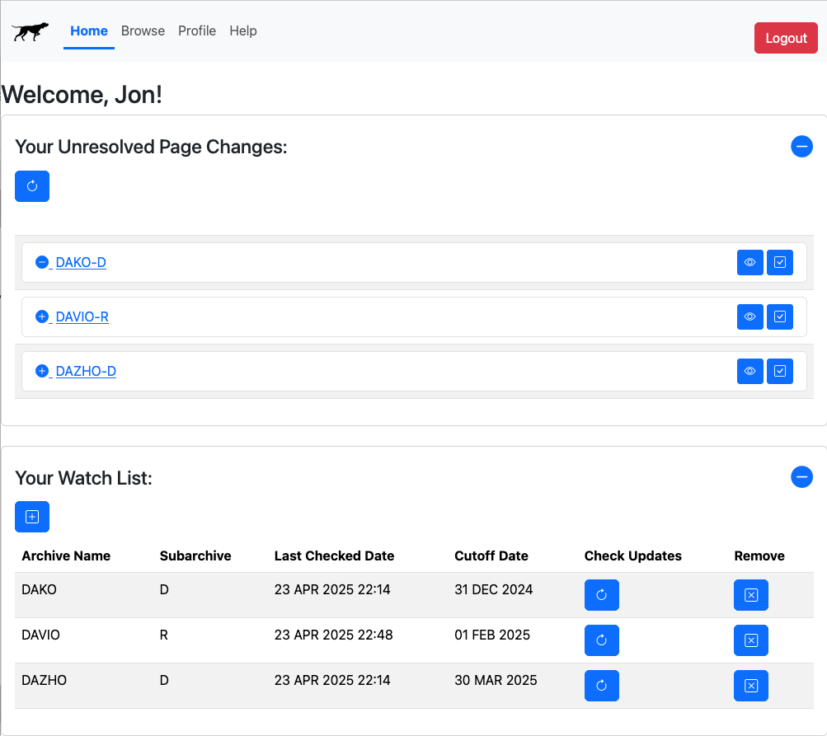
Demo

Slide 4
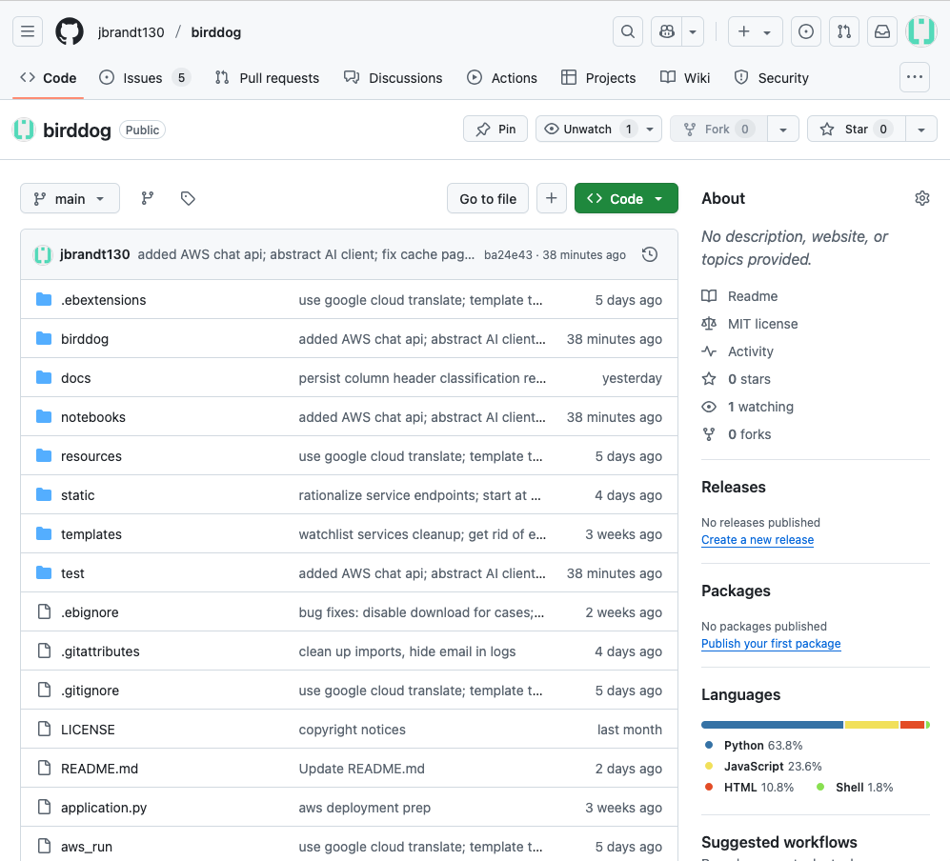
Open Source Code Repo

Slide 5
Next Steps
Near term:
Testing with Wendy and Juliana
Bug-fixing & improvements
Cost monitoring
Documentation (for users & future developers)
Longer term:
Investigate AI-based classification (e.g. Jewish/non-Jewish)
Other workflow streamlining…?

